Slide 1
0930714
Digital Image Processing
Zhilai Liu liu6toot@163.com
School of Mathematics,
Liaoning university, Shen Yang

Slide 2
Basic Information
Time & Venue
Tuesday: 15:40 pm – 17:20 pm, East Lecture Hall 101 (All Weeks)
Thursday: 10:10 am – 12:00 pm, East Lecture Hall 101(Odd Weeks)
Staff
Instructor: Zhilai Liu(lizhen@cuhk.edu.cn)

Slide 3
Slides
Online address:
https://github.com/icemansina/CUHKSZ_DIP
We use this repository for:
Make announcements
Release lecture slides
Release homework assignments and solutions
Discussions: wechat group

Slide 4
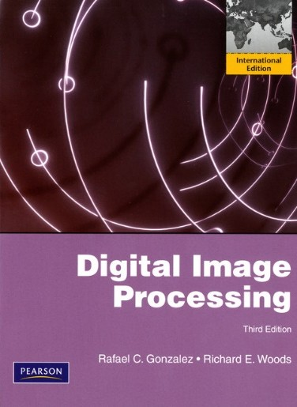
Reference Textbook
Digital Image Processing
By Rafael C. Gonzalez & Richard E. Woods

Slide 5
Grading
Four assignments: 5% x 4
Attendance: 10%
Final Test: 70%
Topics
Applications of digital image processing
Implementation of digital image processing
Study digital image processing algorithms

Slide 6
What is this course about?

Slide 7
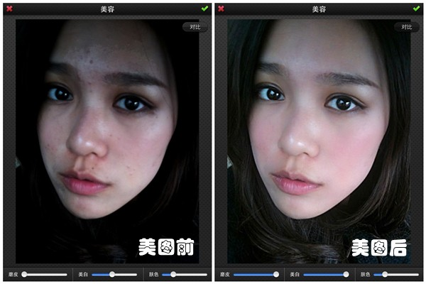
Face Beautification

Slide 8
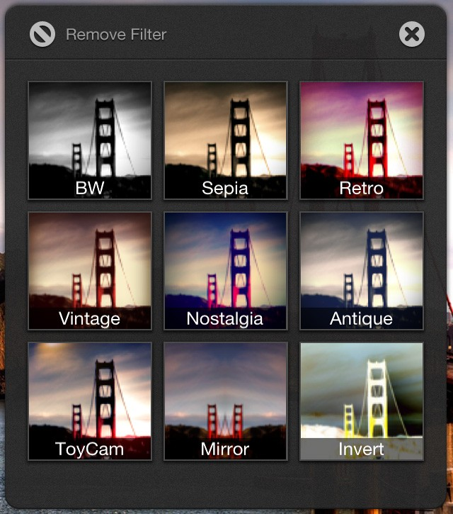
Image Filtering

Slide 9
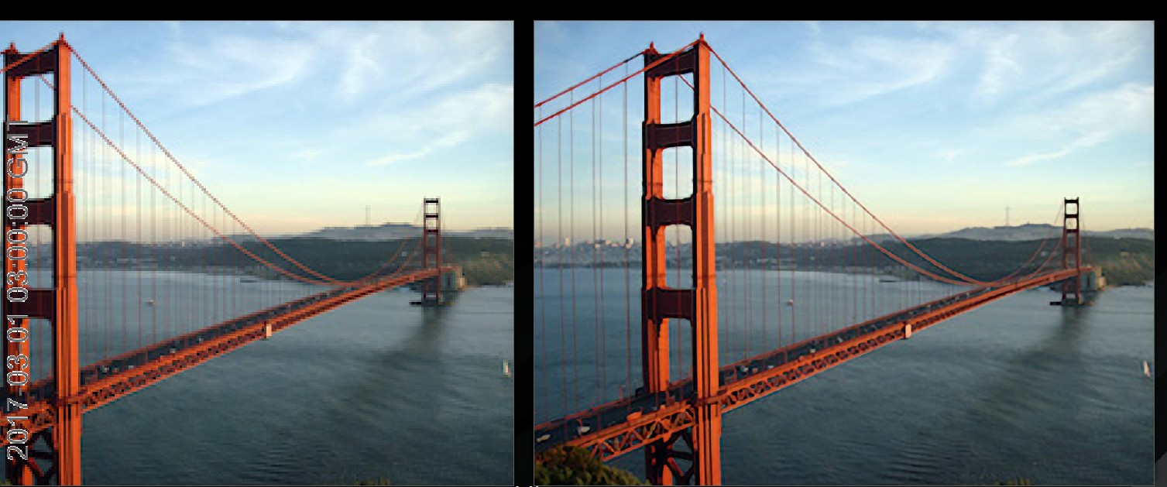
Image Superresolution

Slide 10
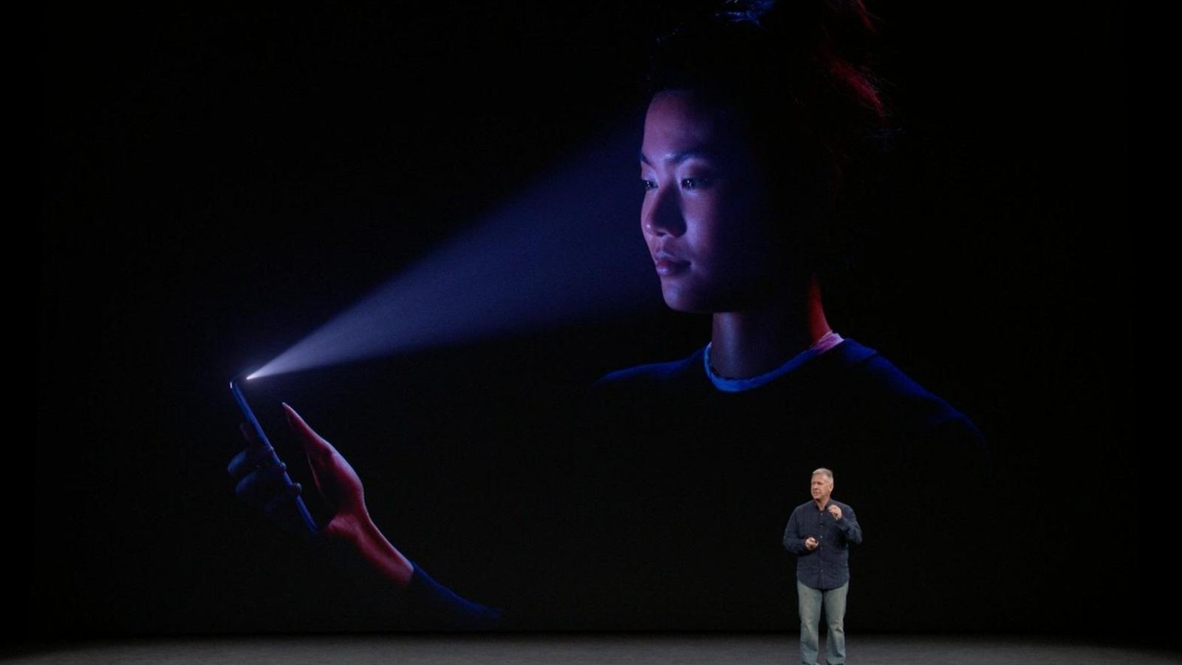
Face Recognition

Slide 11
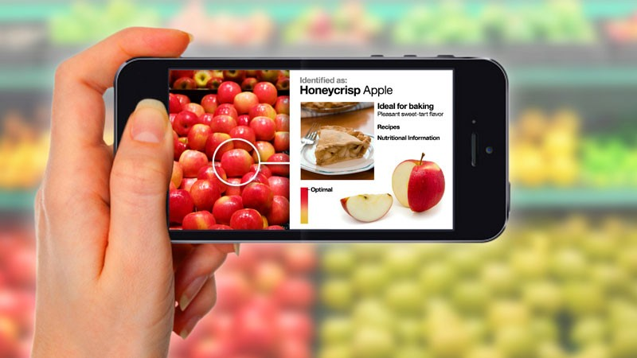
Object Recognition

Slide 12
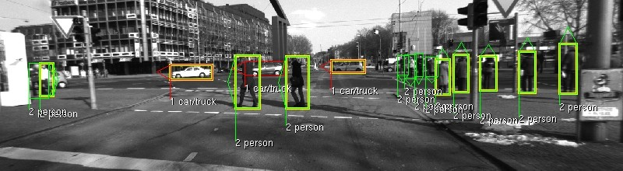
Pedestrian Detection

Slide 13
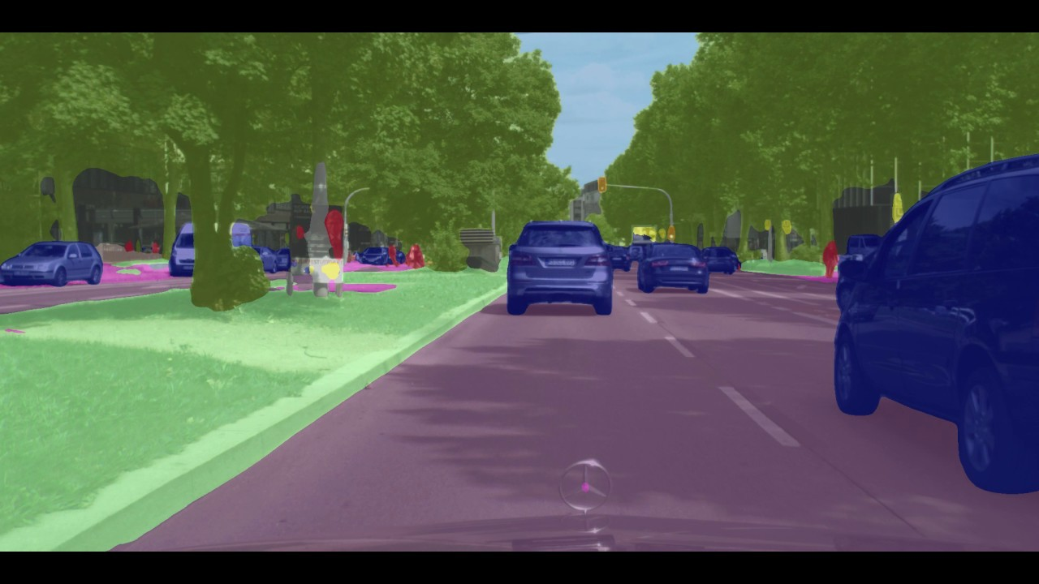
Scene Parsing

Slide 14





Topics
Representation
Processing
Understanding

Slide 15
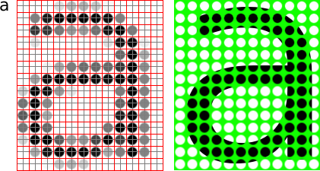
Image Representations
Image Sensing and Acquisition
Sampling and Quantization
Basic Relationships between Pixels

Slide 16
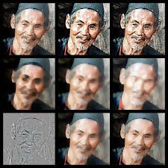
Image Processing
Gray-level processing
Image filtering
Image restoration
Morphological processing

Slide 17
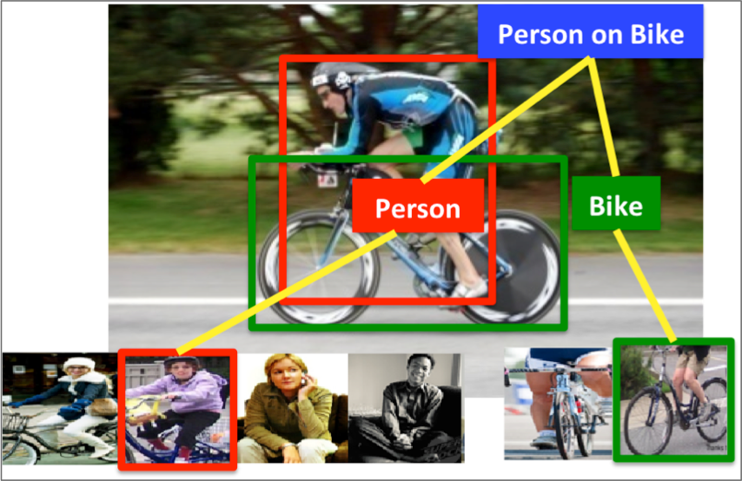
Visual Understanding
Features
Image recognition
Object detection
Image segmentation

Slide 18
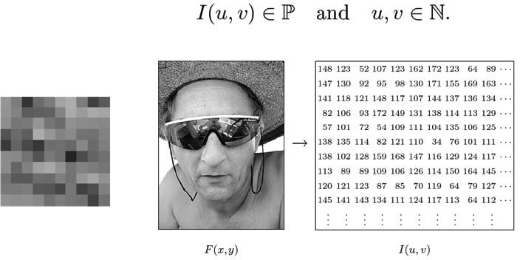
What is an Image?
2‐dimensional matrix of Intensity (gray or color) values
Image coordinates
Set of Intensity values
are integers

Slide 19
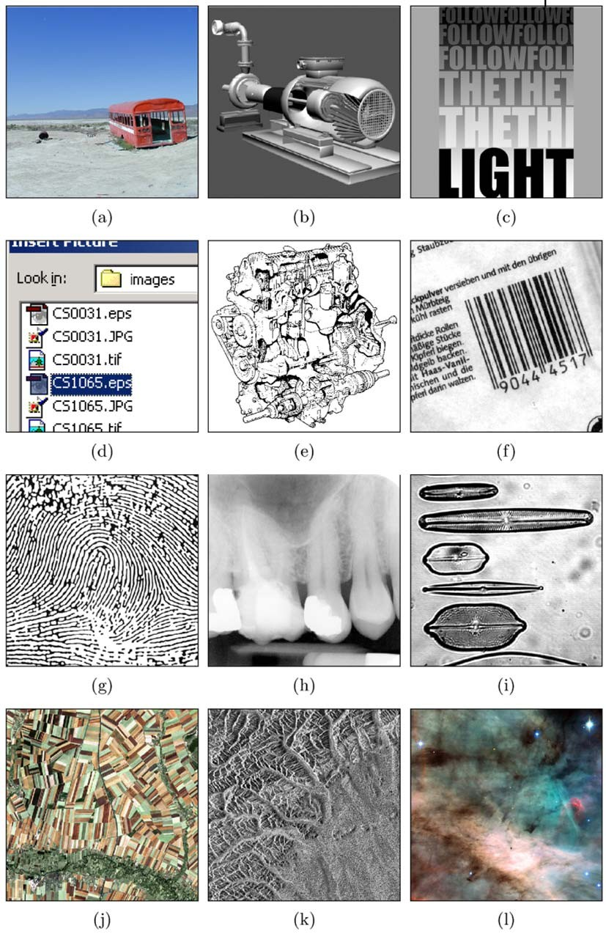
Example of Digital Images
Natural landscape
Synthetically generated scene
Poster graphic
Computer screenshot
Black and white illustration
Barcode
Fingerprint
X‐ray
Microscope slide
Satellite Image
Radar image
Astronomical object

Slide 20
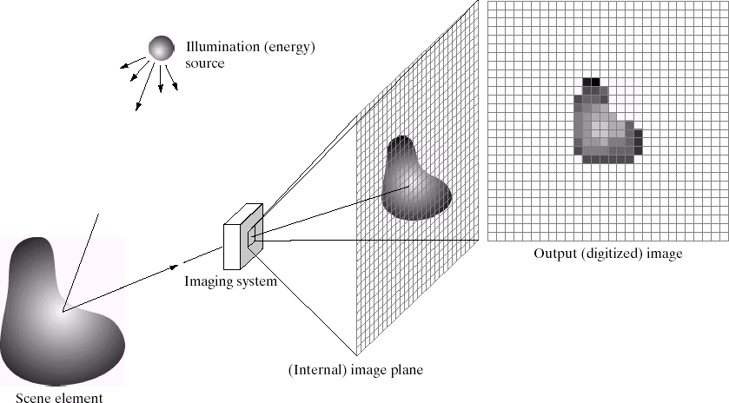
Imaging System
Example: a camera Converts light to image
Credits: Gonzales and Woods

Slide 21
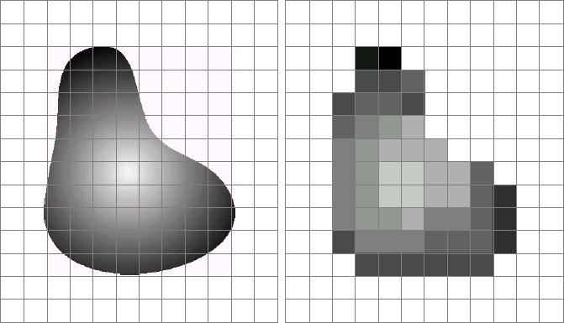
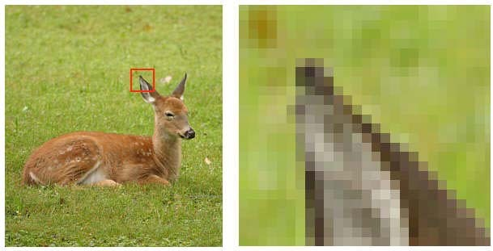


Digital Image?
Images taken from Gonzalez & Woods, Digital Image Processing (2002)
Remember: digitization causes a digital image to become an approximation of a real scene
1 pixel
Real image
Digital Image
(an approximation)
Real image
Digital Image
(an approximation)

Slide 22
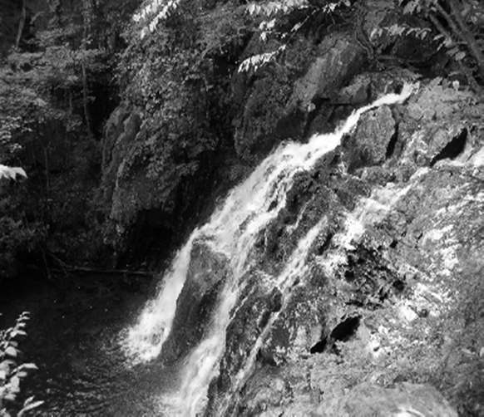
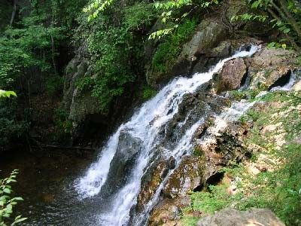
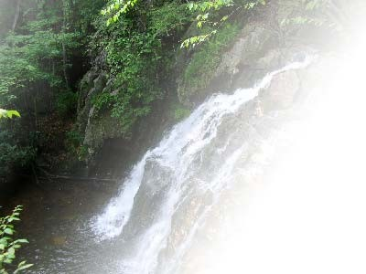
Digital Image
Common image formats include:
1 values per point/pixel (B&W or Grayscale)
3 values per point/pixel (Red, Green, and Blue)
4 values per point/pixel (Red, Green, Blue, + “Alpha” or Opacity)
Grayscale RGB
RGBA
We will start with gray‐scale images, extend to color later

Slide 23
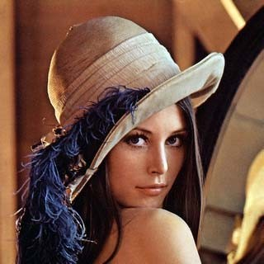
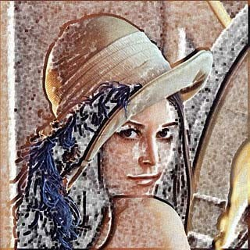
What is image Processing?
Algorithms that alter an input image to create new image
Input is image, output is image
Image Processing Algorithm
(e.g. Sobel Filter)
Original Image Processed Image
Improves an image for human interpretation in ways including:
Image display and printing
Image editting
Image enhancement
Image compression

Slide 24
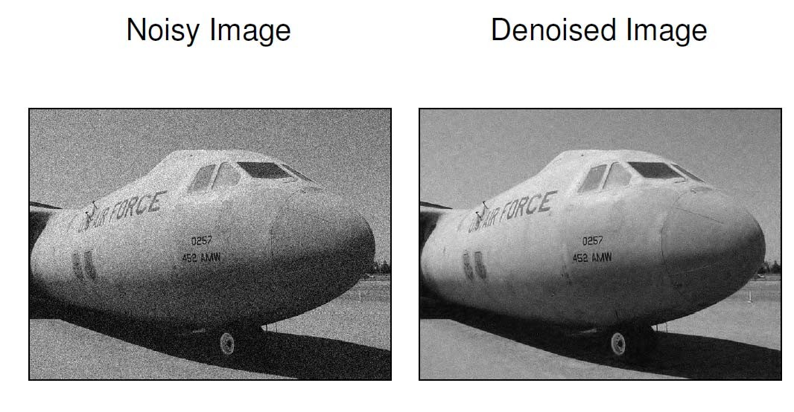
Example Operation: Noise Removal
Think of noise as white specks on a picture (random or non-random)

Slide 25

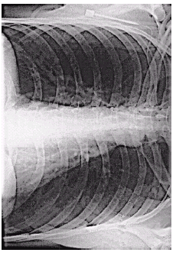
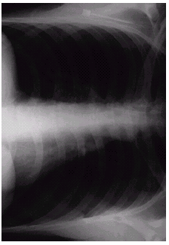

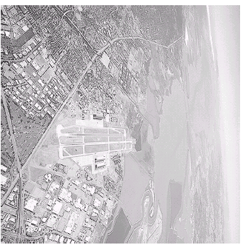
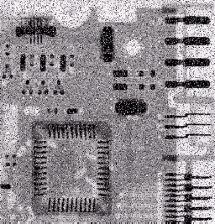
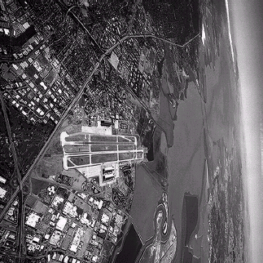
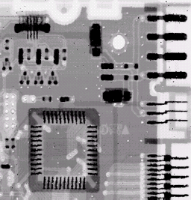
Images taken from Gonzalez & Woods, Digital Image Processing (2002)
Examples: Noise Removal

Slide 26
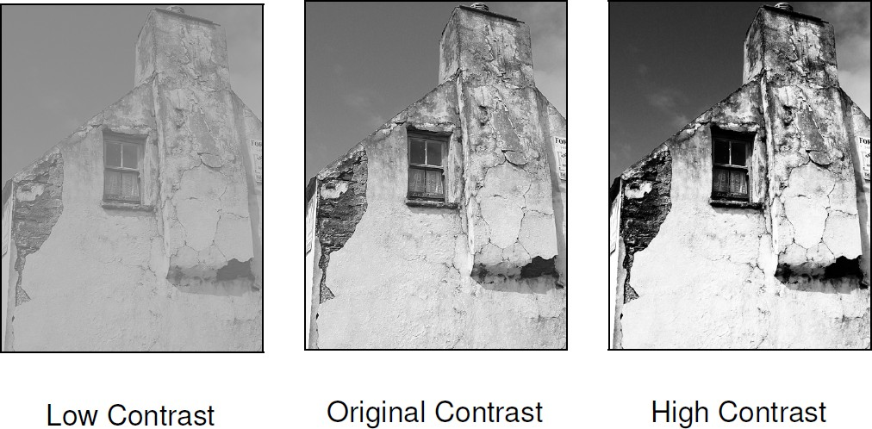
Example: Contrast Adjustment

Slide 27
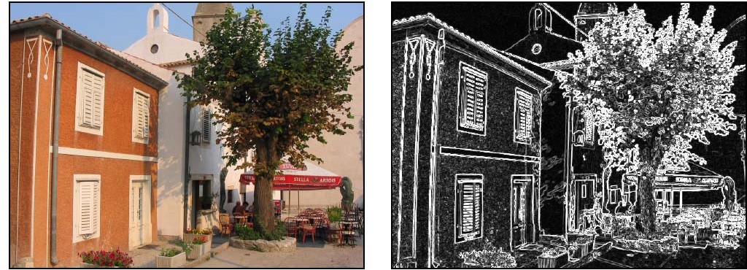
Example: Edge Detection

Slide 28
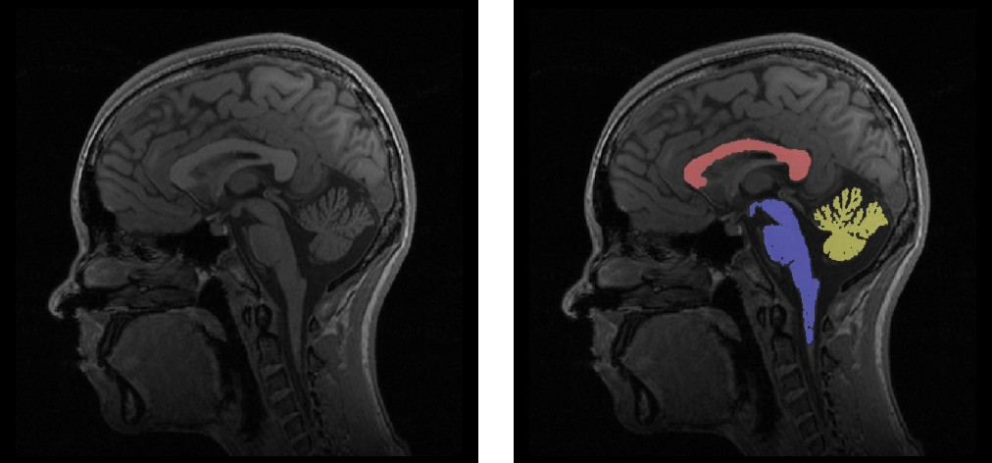
Example: Region Detection, Segmentation

Slide 29
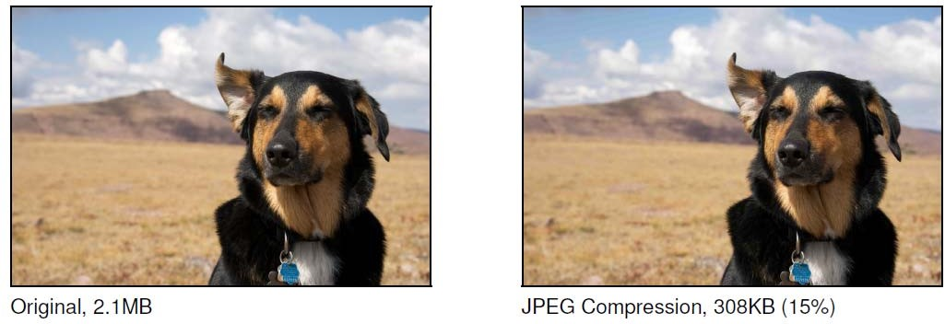
Example: Image Compression

Slide 30
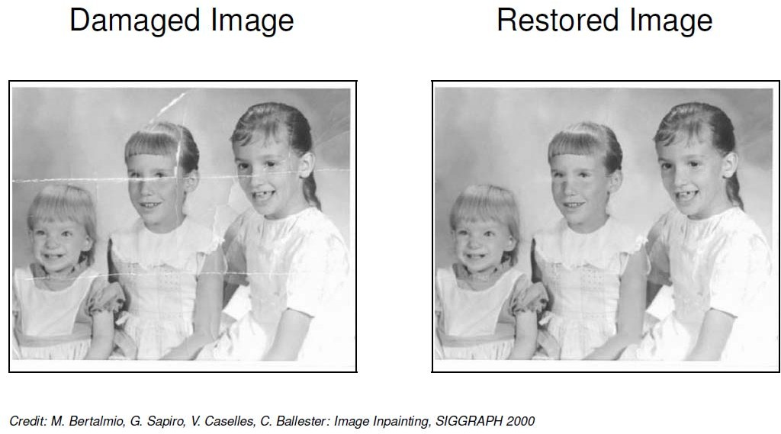
Example: Image Inpainting
Inpainting? Reconstruct corrupted/destroyed parts of an image

Slide 31
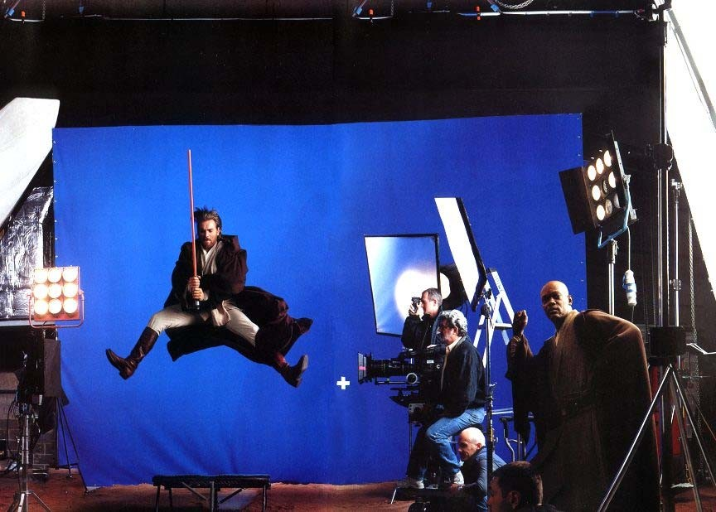
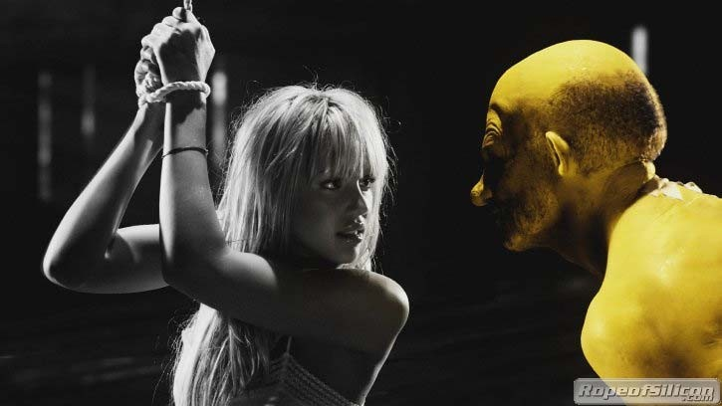
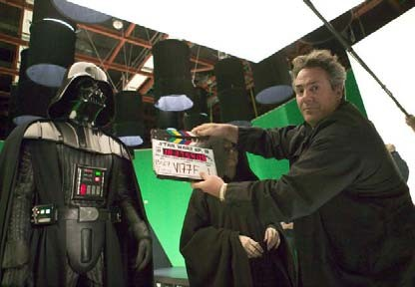
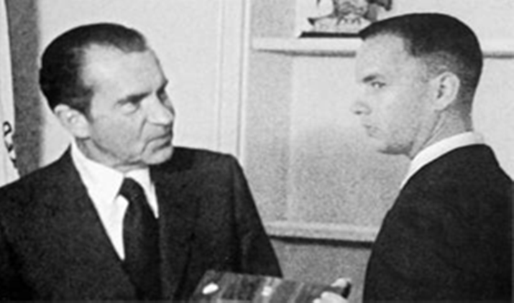
Examples: Artistic (Movie Special )Effects

Slide 32
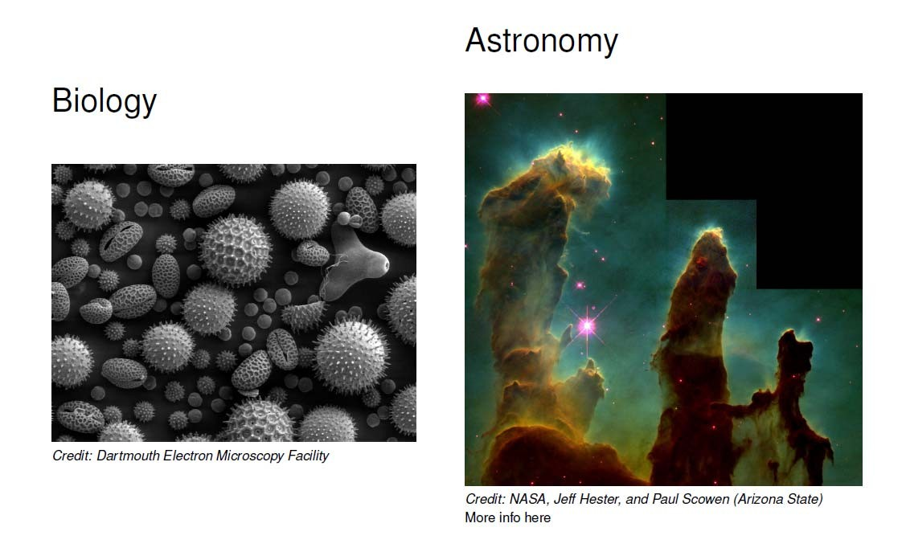
Applications of Image Processing
● dd

Slide 33
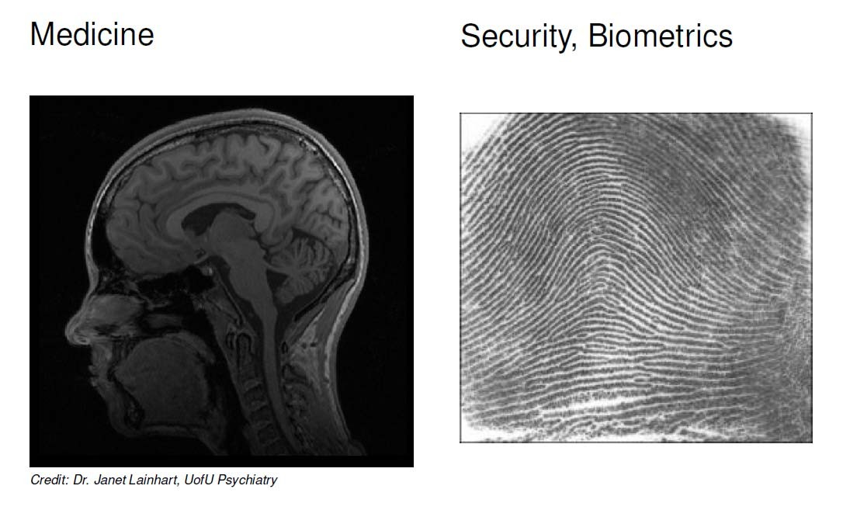
Applications of Image Processing
● dd

Slide 34
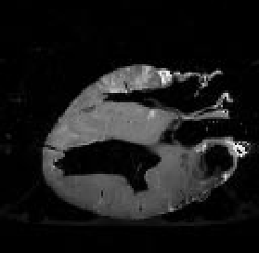
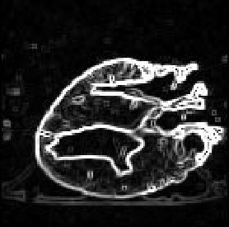
Applications of Image Processing: Medicine
Images taken from Gonzalez & Woods, Digital Image Processing (2002)
Original MRI Image of a Dog Heart
Edge Detection Image

Slide 35
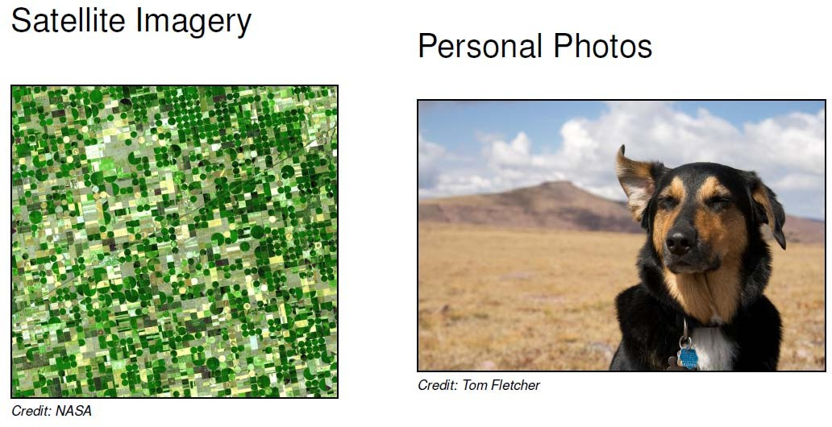
Applications of Image Processing
● dd

Slide 36
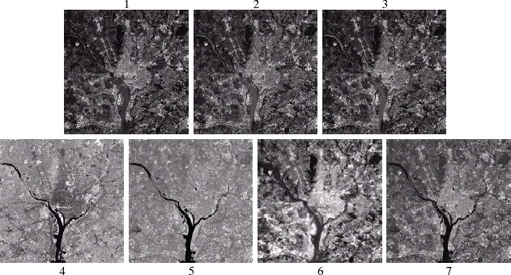
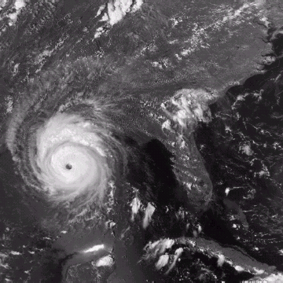
Applications of Image Processing: Geographic Information Systems (GIS)
Images taken from Gonzalez & Woods, Digital Image Processing (2002)
Terrain classification
Meteorology (weather)

Slide 37
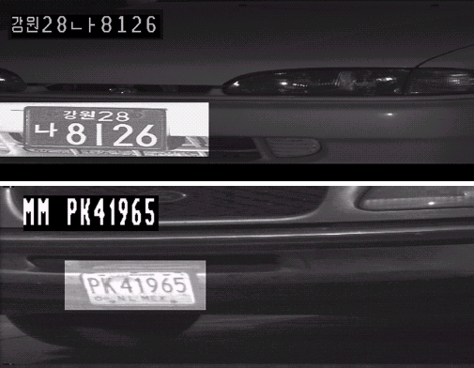
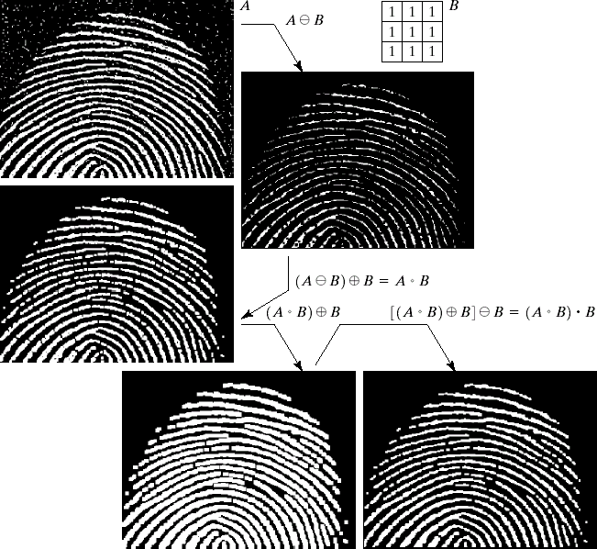
Applications of Image Processing: Law Enforcement
Images taken from Gonzalez & Woods, Digital Image Processing (2002)
Number plate recognition for speed cameras or automated toll systems
Fingerprint recognition

Slide 38
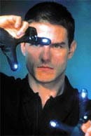
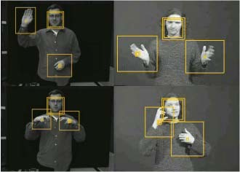
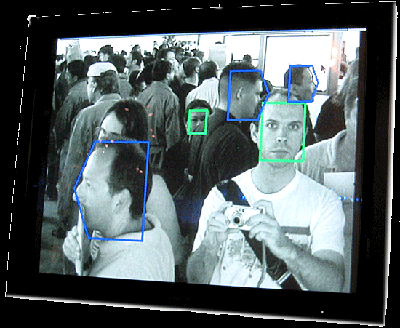
Applications of Image Processing: HCI
Face recognition
Gesture recognition

Slide 39
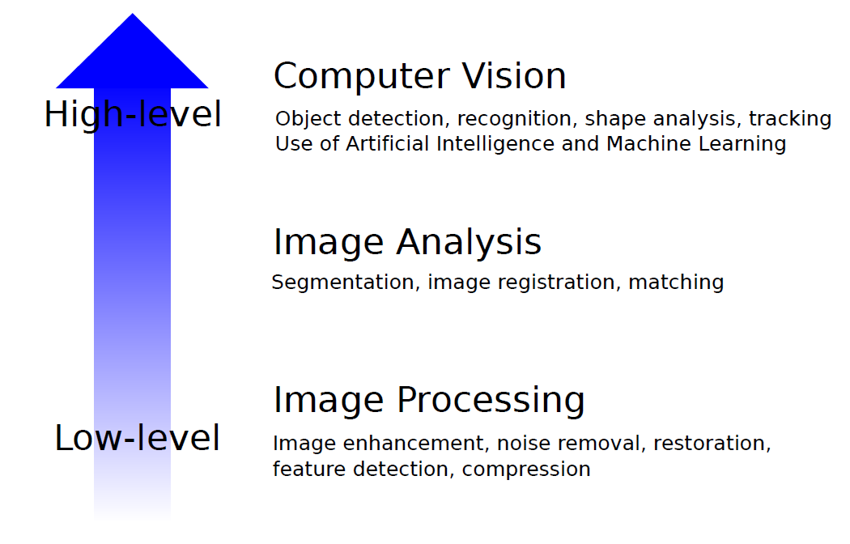
Relationship with other Fields

Slide 40
Key Stages in Digital Image Processing
Image Restoration
Morphological Processing
Image Enhancement
Segmentation
Image Acquisition
Representation & Description
Problem Domain
Object recognition
Colour Image Processing
Image Compression

Slide 41
Key Stages in Digital Image Processing: Image Aquisition
Images taken from Gonzalez & Woods, Digital Image Processing (2002)
Image Restoration
Morphological Processing
Image Enhancement
Segmentation
Image Acquisition
Representation & Description
Problem Domain
Example: Take a picture
Object recognition
Colour Image Processing
Image Compression

Slide 42


Key Stages in Digital Image Processing: Image Enhancement
Images taken from Gonzalez & Woods, Digital Image Processing (2002)
Image Restoration
Morphological Processing
Image Enhancement
Segmentation
Image Acquisition
Representation & Description
Example: Change contrast
Object recognition
Problem Domain
Colour Image Processing
Image Compression

Slide 43


Key Stages in Digital Image Processing: Image Restoration
Images taken from Gonzalez & Woods, Digital Image Processing (2002)
Image Restoration
Morphological Processing
Example: Remove Noise
Segmentation
Image Enhancement
Image Acquisition
Representation & Description
Object recognition
Image Compression
Problem Domain
Colour Image Processing

Slide 44
Key Stages in Digital Image Processing: Morphological Processing
Images taken from Gonzalez & Woods, Digital Image Processing (2002)
Morphological Processing
Extract
Image Restoration
attributes useful for describing image
Image Enhancement
Segmentation
Image Acquisition
Representation & Description
Problem Domain
Object recognition
Colour Image Processing
Image Compression

Slide 45

Key Stages in Digital Image Processing: Segmentation
Images taken from Gonzalez & Woods, Digital Image Processing (2002)
Divide
Image Restoration
Morphological Processing
image into constituent parts
Image Enhancement
Segmentation
Image Acquisition
Representation & Description
Problem Domain
Object recognition
Colour Image Processing
Image Compression

Slide 46

Key Stages in Digital Image Processing: Object Recognition
Image regions
Images taken from Gonzalez & Woods, Digital Image Processing (2002)
Image Restoration
Morphological Processing
transformed suitable for computer processing
Image Enhancement
Segmentation
Image Acquisition
Representation & Description
Problem Domain
Object recognition
Colour Image Processing
Image Compression

Slide 47


Key Stages in Digital Image Processing: Representation & Description
Images taken from Gonzalez & Woods, Digital Image Processing (2002)
Finds &
Image Restoration
Morphological Processing
Labels objects in scene (e.g. motorbike)
Image Enhancement
Segmentation
Image Acquisition
Representation & Description
Object recognition
Problem Domain
Colour Image Processing
Image Compression

Slide 48

Key Stages in Digital Image Processing: Image Compression
Image Restoration
Morphological Processing
Reduce image size (e.g. JPEG)
Image Enhancement
Segmentation
Image Acquisition
Representation & Description
Problem Domain
Object recognition
Colour Image Processing
Image Compression

Slide 49

Key Stages in Digital Image Processing: Colour Image Processing
Image Restoration
Morphological Processing
Image Enhancement
Segmentation
Image Acquisition
Representation & Description
Problem Domain
Object recognition
Consider color images (color models, etc)
Colour Image Processing
Image Compression

Slide 50

Light And The Electromagnetic Spectrum
Light: just a particular part of electromagnetic spectrum that can be sensed by the human eye
The electromagnetic spectrum is split up according to the wavelengths of different forms of energy

Slide 51







Reflected Light
The colours humans perceive are determined by nature of light reflected from an object
For example, if white light (contains all wavelengths) is shone onto green object
it absorbs most wavelengths absorbed except green wavelength (color)
Colours Absorbed

Slide 52

Electromagnetic Spectrum and IP
Images can be made from any form of EM radiation

Slide 53
Images from Different EM Radiation
Radar imaging (radio waves)
Magnetic Resonance Imaging (MRI) (Radio waves)
Microwave imaging
Infrared imaging
Photographs
Ultraviolet imaging telescopes
X‐rays and Computed tomography
Positron emission tomography (gamma rays)
Ultrasound (not EM waves)

Slide 54


Human Visual System: Structure Of The Human Eye
The lens focuses light from objects onto the retina
Retina covered with light receptors called cones (6‐7 million) and rods (75‐150 million)
视椎细胞
Cones concentrated
around fovea. Very sensitive to colour
视杆细胞
Rods more spread out
and sensitive to low illumination levels
Images taken from Gonzalez & Woods, Digital Image Processing (2002)

Slide 55

Image Formation In The Eye
Muscles in eye can change the shape of the lens allowing us focus on near or far objects
An image is focused onto retina exciting the rods and cones and send signals to the brain

Slide 56


Image Formation
The Pinhole Camera (abstraction)
First described by ancient Chinese and Greeks (300‐400AD)

Slide 57

Thin Lens

Slide 58
Brightness Adaptation & Discrimination
The human visual system can perceive approximately 10¹⁰ different light intensity levels
However, at any one time we can only discriminate between a much smaller number – brightness adaptation
Similarly, perceived intensity of a region is related to the light intensities of the regions surrounding it

Slide 59


Brightness Adaptation & Discrimination: Mach Band Effect
Images taken from Gonzalez & Woods, Digital Image Processing (2002)
Perceived intensity overshoots or undershoots at areas of intensity change

Slide 60

Brightness Adaptation & Discrimination
Images taken from Gonzalez & Woods, Digital Image Processing (2002)
An example of simultaneous contrast
All inner squares have same intensity but appear darker as outer square (surrounding area) gets lighter

Slide 61

Image Acquisition
Images typically generated by illuminating a scene
and absorbing energy reflected by scene objects
Images taken from Gonzalez & Woods, Digital Image Processing (2002)

Slide 62


Image Sensing
Images taken from Gonzalez & Woods, Digital Image Processing (2002)
Incoming energy (e.g. light) lands on a sensor material responsive to that type of energy, generating a voltage
Collections of sensors are arranged to capture images
Imaging Sensor
Line of Image Sensors
Array of Image Sensors

Slide 63


Spatial Sampling
Cannot record image values for all (x,y)
Sample/record image values at discrete (x,y)
Sensors arranged in grid to sample image

Slide 64

Image (Spatial) Sampling
A digital sensor can only measure a limited number of
samples at a discrete set of energy levels
Sampling can be thought of as: Continuous signal x comb function

Slide 65

Image Quantization
Quantization: process of converting continuous analog
signal into its digital representation
Discretize image I(u,v) values
Limit values image can take

Slide 66
Image Sampling And Quantization
Images taken from Gonzalez & Woods, Digital Image Processing (2002)
Sampling and quantization generates
approximation of a real world scene

Slide 67

Image as Discrete Function

Slide 68

Image as a Function

Slide 69

Representing Images
Image data structure is 2D array of pixel values
Pixel values are gray levels in range 0‐255 or RGB colors
Array values can be any data type (bit, byte, int, float, double, etc.)

Slide 70


Spatial Resolution
The spatial resolution of an image is determined by how fine/coarse sampling was carried out
Spatial resolution: smallest discernable image detail
Vision specialists
talk about image resolution
Graphic designers talk about dots per inch (DPI)

Slide 71


Images taken from Gonzalez & Woods, Digital Image Processing (2002)
Spatial Resolution

Slide 72






Images taken from Gonzalez & Woods, Digital Image Processing (2002)
Spatial Resolution: Stretched Images

Slide 73
Intensity Level Resolution
Intensity level resolution: number of intensity levels used to represent the image
The more intensity levels used, the finer the level of detail discernable in an image
Intensity level resolution usually given in terms of number of bits used to store each intensity level
Number of Bits | Number of Intensity Levels | Examples
1 | 2 | 0, 1
2 | 4 | 00, 01, 10, 11
4 | 16 | 0000, 0101, 1111
8 | 256 | 00110011, 01010101
16 | 65,536 | 1010101010101010

Slide 74


Images taken from Gonzalez & Woods, Digital Image Processing (2002)
Intensity Level Resolution

Slide 75

Saturation & Noise
Images taken from Gonzalez & Woods, Digital Image Processing (2002)
Saturation: highest intensity value above which color is washed out
Noise: grainy texture pattern

Slide 76
Resolution: How Much Is Enough?
The big question with resolution is always how much is enough?
Depends on what is in the image (details) and what you would like to do with it (applications)
Key questions:
Does image look aesthetically pleasing?
Can you see what you need to see in image?

Slide 77


Resolution: How Much Is Enough?
Example: Picture on right okay for counting number of cars, but not for reading the number plate

Slide 78

Intensity Level Resolution
Images taken from Gonzalez & Woods, Digital Image Processing (2002)
Low Detail
Medium Detail
High Detail

Slide 79


Resampling & Interpolation
First step: align the grid.
Second step:
Set the values at the new grid.
How can we get the values at
sub-pixel locations?

Slide 80



Nearest Neighbor Interpolation
For each new pixel, look for the closest pixel in the original image and assign the value of that pixel to the new pixel.
will take value of

Slide 81



Issues of Nearest Neighbor Interpolation
Checkerboard artifact

Slide 82
Linear Interpolation
(x+1, v)
(x+a, y?)
(x, u)
x
x+a
x+1
y — u ₌ v — u a 1
=) y = u + a(v — u) = (1 — a)u + av

Slide 83
Bilinear Interpolation
(x, y)
(x+1, y)
b
f˜(x⁰, y⁰) = (1 — a)(1 — b) · f (x, y)
+ a(1 — b) · f (x + 1, y)
+ (1 — a)b · f (x, y + 1)
+ ab · f (x + 1,y + 1)
a
?
(x, y+1)
(x+1, y+1)

Slide 84

Comparison of Interpolation Methods
Nearest Neighbor
Bilinear

Slide 85

Adjacency
Adjacency between pixel is an important concept.
It is useful for
Establishing object boundaries
Defining image components/regions

Slide 86
Neighbourhoods of a pixel
p at location (x, y)
N₄(p) = {(x+1,y), (x-1,y), (x,y+1), (x,y-1)}
A pixel p at location (x, y) has two horizontal and two vertical neighbours
This set of four pixels is called 4-neighbours of p, N₄(p)
Each of these neighbours is at a unit distance from p
Fewer neighbours for a boundary pixel

Slide 87
Neighbourhoods of a pixel
p at location (x, y)
N_{D}(p) = {(x+1,y-1), (x-1,y+1), (x+1,y+1), (x-1,y-1)}
A pixel p at location (x, y) also has four diagonal neighbours,
N_{D}(p)
Fewer neighbours for a boundary pixel

Slide 88
Neighbourhoods of a pixel
∪
=
N₈(p) = N₄(p) ∪ N_{D}(p)
The points of N₄(p) and N_{D}(p) together form the 8- neighbours of p

Slide 89
Neighbourhoods of a pixel
4-neighbours of p :
N₄(p) = {(x+1,y), (x-1,y), (x,y+1), (x,y-1)}
4 diagonal neighbours of p :
N_{D}(p) = {(x+1,y-1), (x-1,y+1), (x+1,y+1), (x-1,y-1)}
8-neighbours of p :
N₈(p) = N₄(p) ∪ N_{D}(p)

Slide 90
What is adjacency?
Two pixels are said to be adjacent if
They are neighbours (N₄, N_{D} or N₈), and
Their intensity values are both in a set V
Let V = {1} and use N₈ neighbor
p at location (x, y)
0 | 0 | 1 | 0
0 | 1 | 0 | 0
0 | 1 | 0 | 1
0 | 0 | 0 | 1
It is adjacent to p
It is a neighbour but not adjacent to p due to different gray level
It is not adjacent to p
since q ∉ N(p)

Slide 91
Three types of Adjacency
4-adjacency
p, q ∈ V
q ∈ N₄(p)
8-adjacency
p, q ∈ V
q ∈ N₈(p)
m-adjacency (mixed adjacency)
p, q ∈ V
q ∈ N₄(p) or
q ∈ N_{D}(p) and N₄(p) ∩ N₄(q) = ∅
No pixels in the set of 4 neighbours of both p and q have values from V

Slide 92
What is adjacency?
Mixed adjacency is introduced to eliminate multiple path connections that often arise with 8-adjacency
0 | 1 |  |  | 1
0 |  |  | 0
 | 1
0 | 0 |  | 1
0
1
1
0
1
1
0
1
0
0
1
0
0
0
1
0
0
1
4-adjacency
8-adjacency
m-adjacency

Slide 93
Path
A path from p(x, y) to q(s, t) is a sequence of distinct pixels
(x₀, y₀), (x₁, y₁), (x₂, y₂), … , (x_{n}, y_{n})
p(x, y)
where
(x₀, y₀) = (x, y), (x_{n}, y_{n}) = (s, t) (x_{i}, y_{i}) is adjacent to (x_{i-1}, y_{i-1}) for 1 ≤ i ≤ n
n = length of path
path
q(s, t)

Slide 94

Connected Component
Let S be a subset of pixels, p and q are said to be connected in S if there exists a path between them that are completely in S.
For any pixel p, the set of pixels that are connected to it in S is called a connected component.
If S contains only one connected component, it is called a connected set.
How many connected components? Using N₄ and N₈ respectively.

Slide 95
Regions
disjoint from R
R is called a region if it is a
Use 4-adjacency
connected set.
Two regions are said to be
adjacent if their union
R
form a connected set,
otherwise they are said to
be disjoint.
The boundary of a region
R is a subset of R in which
all the points are adjacent
to the complement of R.
a boundary pixel of R
adjacent to R

Slide 96
Distances
D is a distance function or metric if
D( p, q) Š 0 (D = 0 iff p = q) (positiveness)
q(s,t)
D( p, q) = D(q, p)
(symmetry)
D( p, z) Š D(q, p) + D(q, z) (triangular inequality)
p( x, y)
z(v, w)
Euclidean distance
D ( p, q) = ( x − s)² + ( y − t)²
e
q(s,t)
p( x, y)

Slide 97


Distances
City-block distance
D₄ ( p, q) =| x − s | + | y − t |
q(s,t)
p
p( x, y)
Chessboard distance
D₈ ( p, q) = max(| x − s |,| y − t |)
p

Slide 98
Distance w.r.t. adjacency
In the simple binary image below, draw a shortest 4-path and a shortest 8-path from pixel p to pixel q (if they exist). The paths must pass through pixels of value 1.
p
1 | 0 | 0 | 1 | 1 | 1
0 | 0 | 0 | 1 | 0 | 0
0 | 1 | 1 | 1 | 1 | 0
0 | 1 | 0 | 0 | 1 | 0
1 | 1 | 1 | 1 | 1 | 0
q

Slide 99


Distance w.r.t. adjacency
Shortest 4-path
Shortest 8-path

Slide 100
Image File Formats
Hundreds of image file formats. Examples
Tagged Image File Format (TIFF)
Graphics Interchange Format (GIF)
Portable Network Graphics (PNG)
JPEG, BMP, Portable Bitmap Format (PBM), etc
Image pixel values can be
Grayscale: 0 – 255 range
Binary: 0 or 1
Color: RGB colors in 0‐255 range (or other color model)
Application specific (e.g. floating point values in astronomy)

Slide 101

How many Bits Per Image Element?

Slide 102
Mathematics for Image Processing
Calculus
Linear algebra
Probability and statistics
Differential Equations (PDEs and ODEs)
Differential Geometry
Harmonic Analysis (Fourier, wavelet, etc)

Slide 103



About This Course
Image Processing has many aspects
Computer Scientists/Engineers develop tools (e.g. photoshop)
Requires knowledge of maths, algorithms, programming
Artists use image processing tools to modify pictures
DOES NOT require knowledge of maths, algorithms, programming
Example: Knoll Light Factory photoshop plugin
Example: Portraiture photoshop plugin
Example: ToonIt photoshop plugin

Slide 104
About This Course
Most hobbyists follow artist path. Not much math!
This Course: Image Processing for computer scientists and Engineers!!!
Teaches concepts, uses Matlab/Python as concrete example
Matlab Image Processing Toolbox
Includes lots of already working algorithms,
Can be extended by programming new image processing techniques
Course is NOT
just about programming Matlab image processing toolbox
a comprehensive course in matlab image processing toolbox and python image processing library (PIL, scipy, opencv-python and so on)
about using packages like Photoshop

Slide 105
About This Course
Class is concerned with:
How to implement image processing algorithms
Underlying mathematics
Underlying algorithms
This course is a lot of work. Especially heavy coding!!!
Requires:
Lots of programming (maybe in MATLAB/Python)
Lots of math, linear systems, fourier analysis

Slide 106
Administrivia: Syllabus Summary
3 Assignments (30%), one Mid-Exam (30%), 1 final Projects (40%)
Projects:
Develop image processing algorithm on any platform using MATLAB/Python
May discuss projects but turn in individual projects
Text:
Digital Image Processing: An Algorithmic Introduction using Java by Wilhelm Burger and Mark J. Burge, Springer Verlag, 2008
Cheating: Immediate ‘F’ in the course
My advice:
Come to class
Read the text
Understand concepts before coding

Slide 107
References
Wilhelm Burger and Mark J. Burge, Digital Image Processing, Springer, 2008
University of Utah, CS 4640: Image Processing Basics, Spring 2012
Gonzales and Woods, Digital Image Processing (3rd edition), Prentice Hall
Digital Image Processing slides by Brian Mac Namee

Slide 108

Thank You

